Slide 1
Ottawa, May 6, 2019
Canada's Fundamental Science Review: Progress and Prospects
Notes:
This file contains slides and notes from a talk presented on May 6 2019 – per the title slide. For easy reading, go to ‘View’ in PowerPoint and click ‘Notes Page’ tab.
Many thanks to the Canadian Consortium for Research for the invitation to present!

Slide 2
INVESTING IN CANADA’S FUTURE
Strengthening the Foundations of Canadian Research
“Our government must ensure its support for fundamental research is coherent, effective and agile enough to keep pace with the dynamic nature of contemporary science.” — The Honourable Kirsty Duncan, Minister of Science
Panelists
C. David Naylor | Robert J. Birgeneau | Martha Crago
Mike Lazaridis | Claudia Malacrida | Arthur B. McDonald
Martha C. Piper | Rémi Quirion | Anne Wilson
Notes:
Kudos to Science Minister Kirsty Duncan for commissioning first overall review of extramural funding and the related research ecosystem since a major study undertaken by a Senate Standing Committee in the 1970s. Panel members listed on screen. Enormous privilege to have worked with these distinguished and wise individuals, as well as with a very skilled and dedicated secretariat. Bio details and full acknowledgments in the FSR report.

Slide 3
The content and uptake of the FSR Report is in very large measure a reflection of the extraordinary commitment of:
Canada’s researchers for their input and support
Canadian associations (not least CCR and its members), universities, hospitals, institutes, think tanks, & many other entities for input and advocacy
Students and Trainees who give us great hope for a better future!
Notes:
Self-explanatory. Report was given an oddly chilly reception by the Government until the research community mobilized in the summer and fall of 2017.
Special thanks to the Science & Policy Exchange who mobilized #Students4TheReport and reminded everyone, not least the PM and Cabinet members, that support for independent extramural research is among the best imaginable investments in the future of Canada.

Slide 4
MANDATE AND CONSULTATIONS
Two main mandate questions:
Are there any overall program gaps in Canada’s fundamental research funding ecosystem that need to be addressed?
Are there elements or programming features in other countries that could provide a useful example for the Government of Canada in addressing these gaps?
Consultation
1,275 submissions from individuals, associations, and other organizations.
Roundtables in five Canadian cities engaging 230 researchers.
Notes:
Self-explanatory. Amazingly high-quality submissions and discussions. The Report would have been radically weaker without the superb input of the Canadian research community. And any progress in its implementation (see below) has been overwhelmingly due to the support of diverse stakeholder groups and countless individual researchers.

Slide 5
Recommendation 1.1
Consistent with the recommendation by the Advisory Council on Economic Growth, the Government of Canada should undertake a wide-ranging and multi-departmental review of innovation-related programming, including both direct and indirect supports for business research and development.
Notes:
Recommendation from both the Growth Council and the FSR Panel. Federal government has made new investments totaling in the billions to support its business-facing innovation agenda. Although the shift to direct funding of industry R&D by the federal government is welcome, there has been no obvious reduction/redirection of indirect support already offered in the form of SRED tax credits that are much more generous in Canada than peer nations.
Treasury Board has undertaken an internal review and harmonization of innovation programming. A positive step. However, that’s not a substitute for an arm’s length, publicly-accessible, and rigorous assessment of the existing and new supports to industry R&D in Canada, including those inside the three granting councils..

Slide 6
The Panel’s Report includes 34 more Recommendations that cover:
Governance, Oversight, Coordination, and stronger and more equitable Adjudication and Evaluation
A range of measures to ensure that the Next Generation of Researchers (Grad Students, PDFs, ECRs) have a fair shot at winning appropriate support
Restoration of Core Funding for Independent Research Grants to 2006 in Real Dollar Terms
Myriad New Investments to attract and/or retain top-flight Established Researchers
A Set of Phased Investments to strengthen the Research Environment (e.g. infrastructure and F&A costs), and stabilize Canada’s Big Science Facilities
Notes:
Self-explanatory

Slide 7
Why a vibrant research ecosystem matters:
Living longer and healthier lives in a cleaner and safer environment.
Protecting and enriching Canada’s diverse cultures and heritage.
Developing innovative technologies, goods, and services that contribute to our economic prosperity and create fulfilling jobs.
Sustaining our economic sovereignty, standard of living, and valued social programs.
Fostering a creative, vibrant, and inclusive society.
Stimulating informed public debate.
Supporting evidence-based policy-making in a period of accelerating change and complex domestic and global challenges.
Educating and inspiring the next generation of innovators in all walks of life.
Notes:
From the Report, Chapter 2. This should all be self-evident. However, as unreason spreads, and scientific and scholarly perspectives are supplanted by ideology and ‘fake news’, it will be more important than ever to make the case for rigorous and independent research.
Reminder: Research-led education is crucial to creating a pipeline of talent for innovative Canadian businesses.
Yes, some of that talent gets hired by multinationals doing business in Canada. Way better than having the talent emigrate! And every reason to believe Canadian-led companies can and will compete strongly to recruit and retain Canadian-made talent.

Slide 8
Provides the evidence for Evidence-informed Decision Making across a wide range of domains.
Provides the next generation of Highly Qualified Personnel who can ask and answer hard questions. This is essential for a country that aims to lead the world in innovation and social justice.
Provides Thought Leaders who can scan the Canadian and international landscape and translate insights from basic and applied research into ideas, products, and services for private/public sectors & civil society.
Attracts Talented People and Innovative Businesses to Canada.
THE VALUE OF A STRONG RESEARCH ECOSYSTEM
Notes:
Modified from a slide prepared and kindly shared by Professor Emeritus/Nobel Laureate Arthur B. McDonald, panel member extraordinaire.

Slide 9
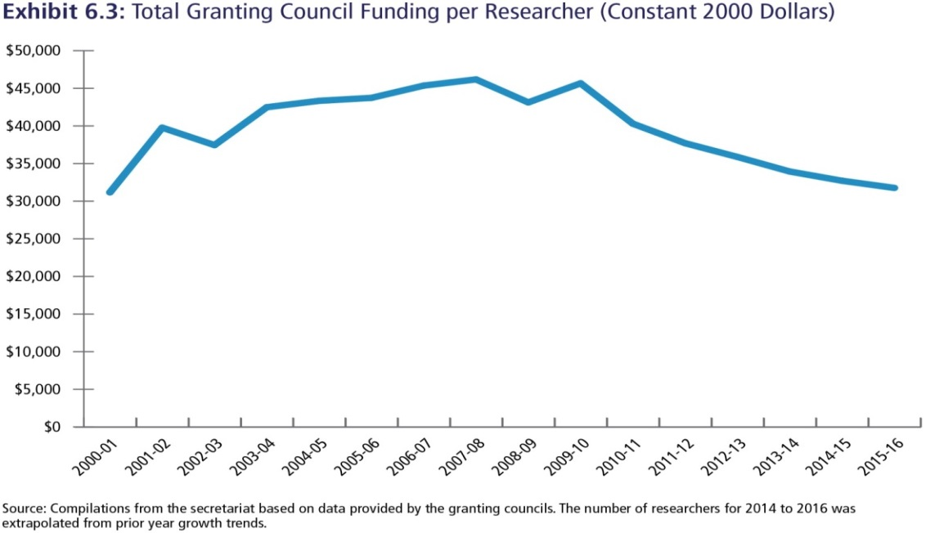
RESOURCES
“As a small country, Canada may not be able to invest in basic research at the same levels as the world’s top economies in absolute terms. However, in relative terms, we must be at or very near the top of the funding pyramid”
Key facts:
Dropped out of top 30 nations for “research intensity”.
GERD intensity declining.
Granting council funding per researcher in steady decline since 2008-09 in constant dollars.
Notes:
Self-explanatory. Canada’s overall spending on R&D as a percentage of GDP (GERD ratio, commonly just called GERD) has been falling relative to peer nations. Continues to be true through 2018 (see next slide).
Granting council funding per researcher was also falling through 2016 – as documented in the FSR report (released in April 2017). Examining recent data, seems to be rising now: good news, but a faster and bigger uptick is still needed!

Slide 10
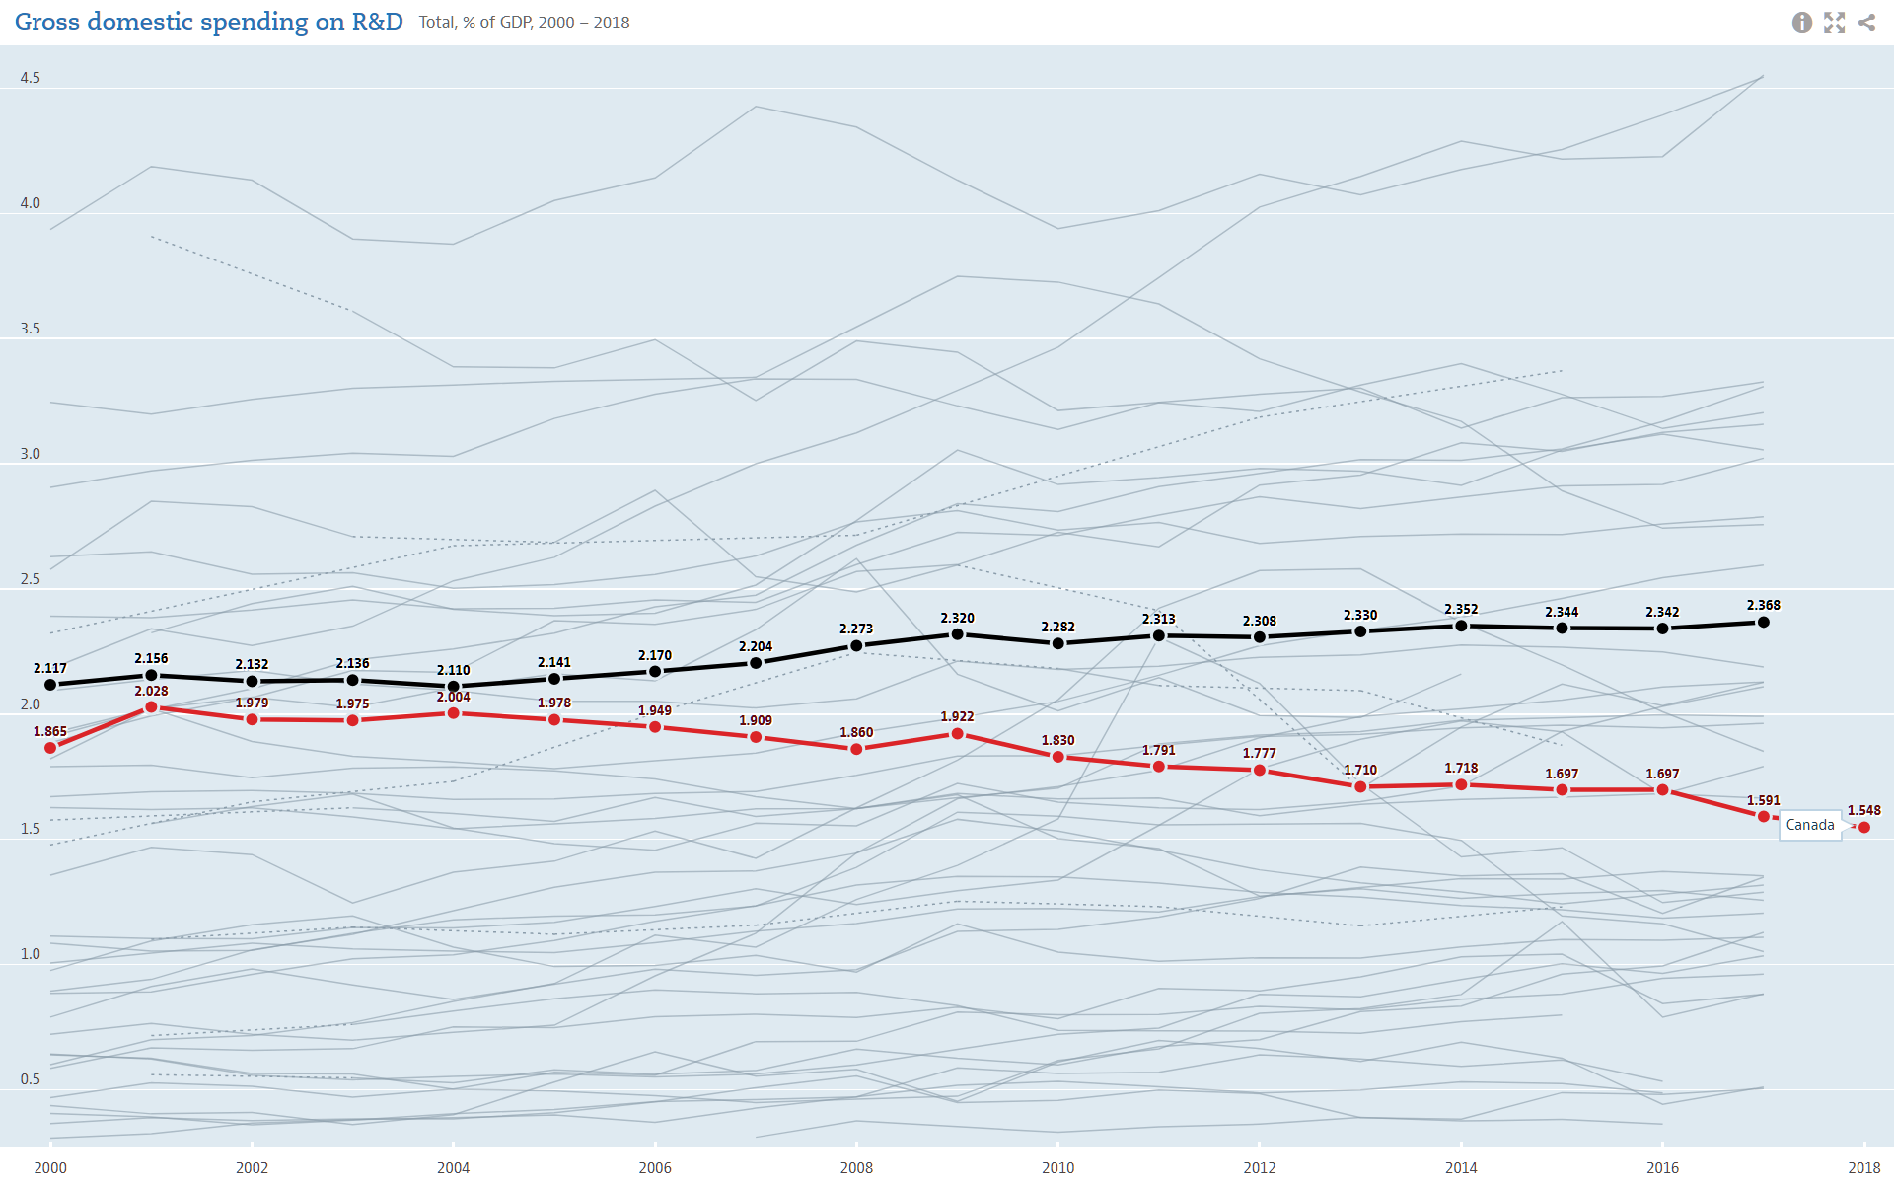
Notes:
Updated profile of GERD performance from OECD data. Canada continues to lose ground relative to OECD nations. Lagging Business Expenditure on R&D [BERD] is a major factor. Discussed later.

Slide 11
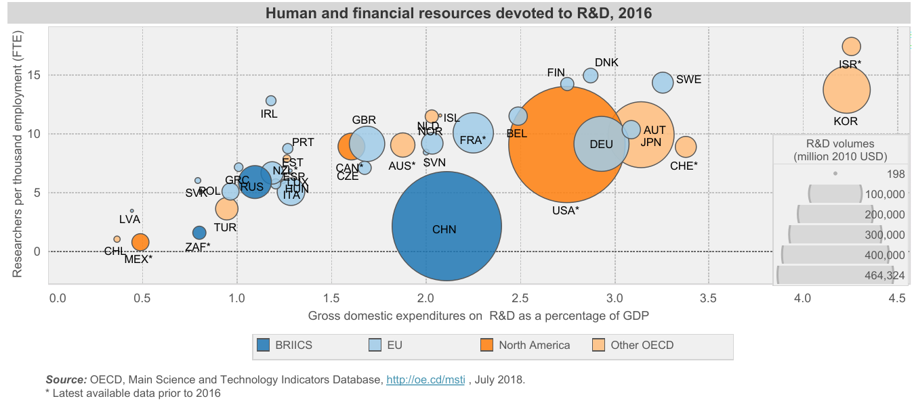
Notes:
A different look at Canada’s standing from OECD data. Researchers per 1000 FTEs in employment is mid-range overall, but below several other small nations. Spending as a percentage of GDP as already shown is low. Total human and financial resources committed to R&D (size of circle) are modest relative to many other nations.
As we emphasized in the FSR report, scale matters. Canada has a small population. The Israelis and Koreans have figured out that they their spending on R&D relative to GDP must be much higher than average to drive an innovation-based economy. Tougher sell in Canada where business does well with very low R&D spending.

Slide 12
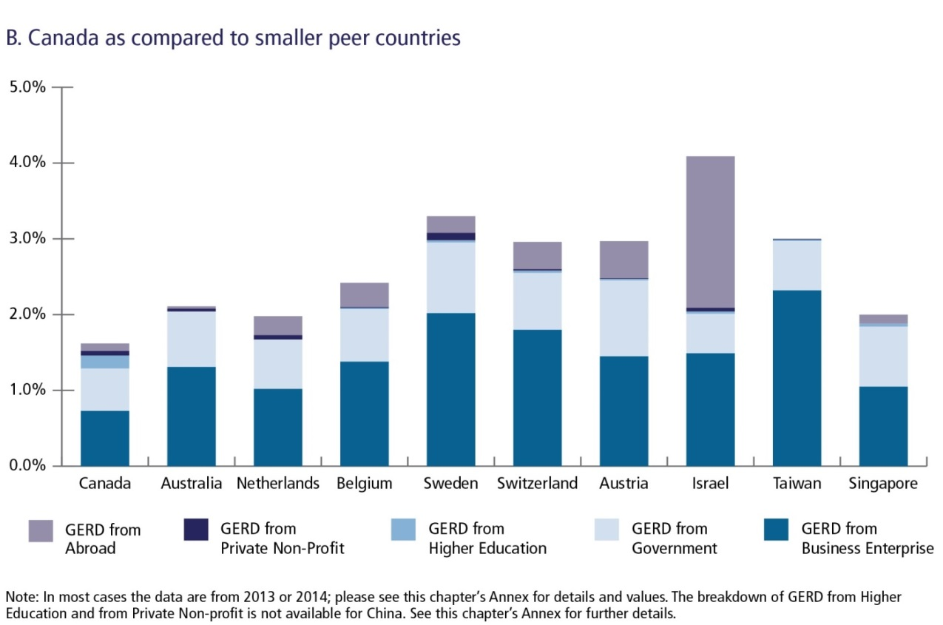
Sources of Gross Domestic R&D Expenditure
Notes:
Not only is GERD low compared to other small nations; Canada is anomalous in that a material proportion of GERD is underwritten by the Higher Education sector. See the light blue band on the Canadian bar, almost invisible for other small countries. Japan and the US also have meaningful cross-subsidization from institutions, but much smaller as a proportion of total GERD.
Basically, Canadian universities and research hospitals are subsidizing Canada’s overall research effort to an extent unseen elsewhere.

Slide 13
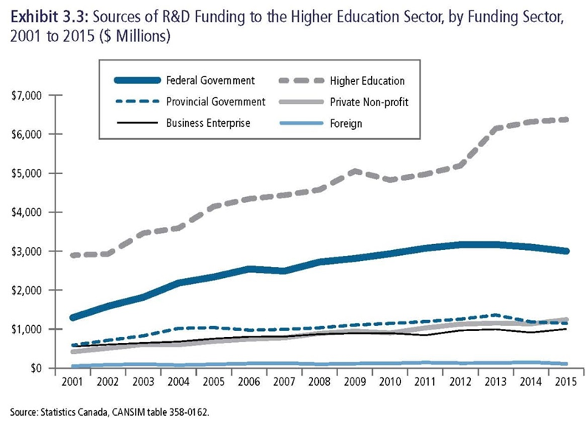
Federal Share of HERD = 23%
Notes:
Instead of focusing on the overall spending on R&D (i.e. GERD), one can break out sources of funding for the dollars spent inside the Higher Education sector relative to GDP – the HERD ratio, or HERD for short.
The majority of spending for HERD comes from the institutions themselves – and the federal share was flat and declining relative to institutional funding – at 23% of the total HERD in 2015. The federal shared has picked up slightly as a result of Budget 2018 – kudos to the federal government. However, Canada remains a clear outlier in sources of research funding within the higher education sector.

Slide 14
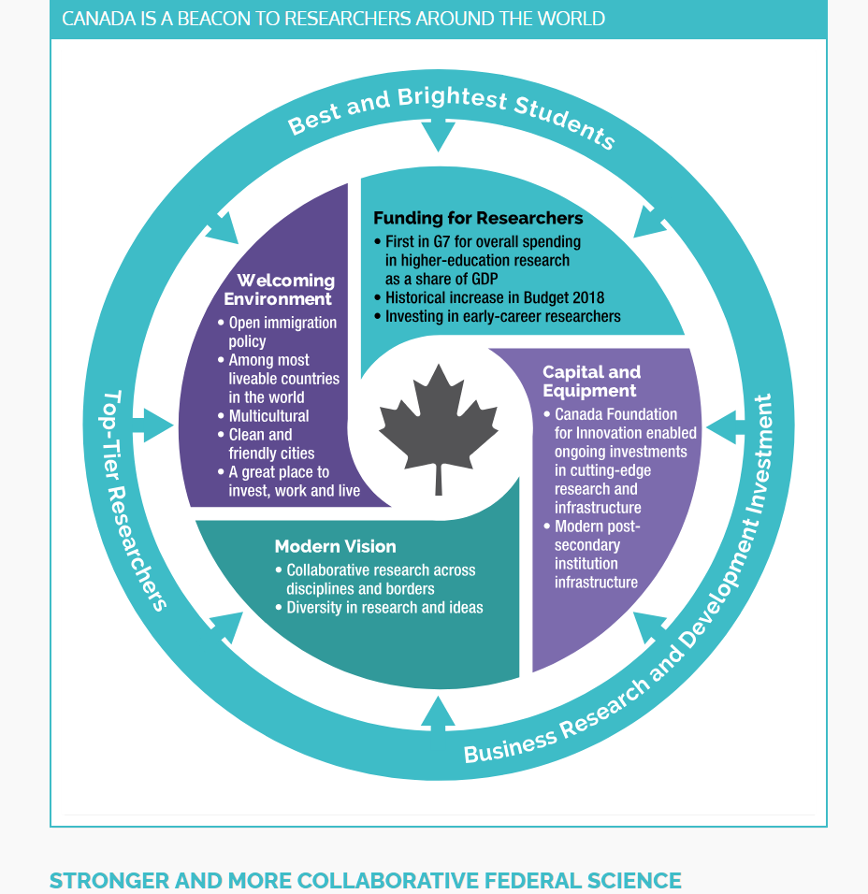
In the past year, the Government of Canada received the report from the expert panel on Canada’s Fundamental Science Review, led by Dr. David Naylor. While Canada spends more on higher-education research and development (as a share of gross domestic product) than any other Group of Seven (G7) country, the Review identified a number of challenges that require urgent attention. (Budget 2018, p89)
Notes:
Given the sources of the funds, it’s maddening that the Government of Canada – earlier the Conservatives and now the Liberals – continues to brag about Canada’s HERD ratio. As shown, this nonsense continued in Budget 2018, even as the Government was announcing new spending on science. Was this designed to ward off criticism that investment in personnel and operating grants ended up being far short of the recommended levels? Or was it just reflex self-congratulation? Whatever the case, the use of this statistic here borders on deceitful. Given the small federal contribution to HERD, this is like a student bragging publicly about their high grade on an essay – when 70% of the essay was plagiarized.

Slide 15
Spending ‘intentions’ 2018
Business sector 41% of GERD = $14.2 billion (92% internal)
Higher education sector 20% of GERD = $7.0 billion
Federal government= 18% of GERD = $6.0 billion (33% internal, 54% Higher Ed)
Foreign sources 11% of GERD = $3.7 billion
Private non-profit 5% of GERD = $1.75 billion
Provincial governments 5% of GERD = $1.75 billion
Notes:
See https://sciencebusiness.net/news-byte/businesses-account-70-rd-expenditure-growth-oecd-countries. Business spending on average makes up 70% of GERD in peer nations. In Canada it’s 41%. Only 8% of that low total investment spent outside the companies themselves. Worldwide, the private sector, not universities, drives patent generation and commercialization of IP, but few Canadian companies invest heavily in contracted-out research. Huge factor in Canada’s low total patent outputs and mediocre commercialization of academic research.
Caveat: For decades countless Canadian-headquartered companies have found ways to be profitable and competitive without major research investments or generation of new IP. So far, so good. But why, then, in 2019 do we again have business leaders squawking about low university patent numbers and commercialization outputs? Makes zero sense.

Slide 16
PERFORMANCE: CCA Citation/Publication Analysis
Key findings:
Canada remains above-average in citations, helped by below-average impact of massive volume of publications from China.
Declining outputs highlighted in the CCA report could be arguably offset if Canadian research showed rising impact as measured by citation analysis. However, while Canada is strong performer in some fields, citation rankings fell in 13 of 22 fields assessed.
Canada lags many other nations in winning international prizes, not least Australia.
Notes:
Self-explanatory. Just want to repeat that the draft CCA report was shared generously with the FSR Panel in 2016-17. Final CCA report released in April 2018. Please see:
https://cca-reports.ca/wp-content/uploads/2018/09/News_Release_EN.pdf

Slide 17
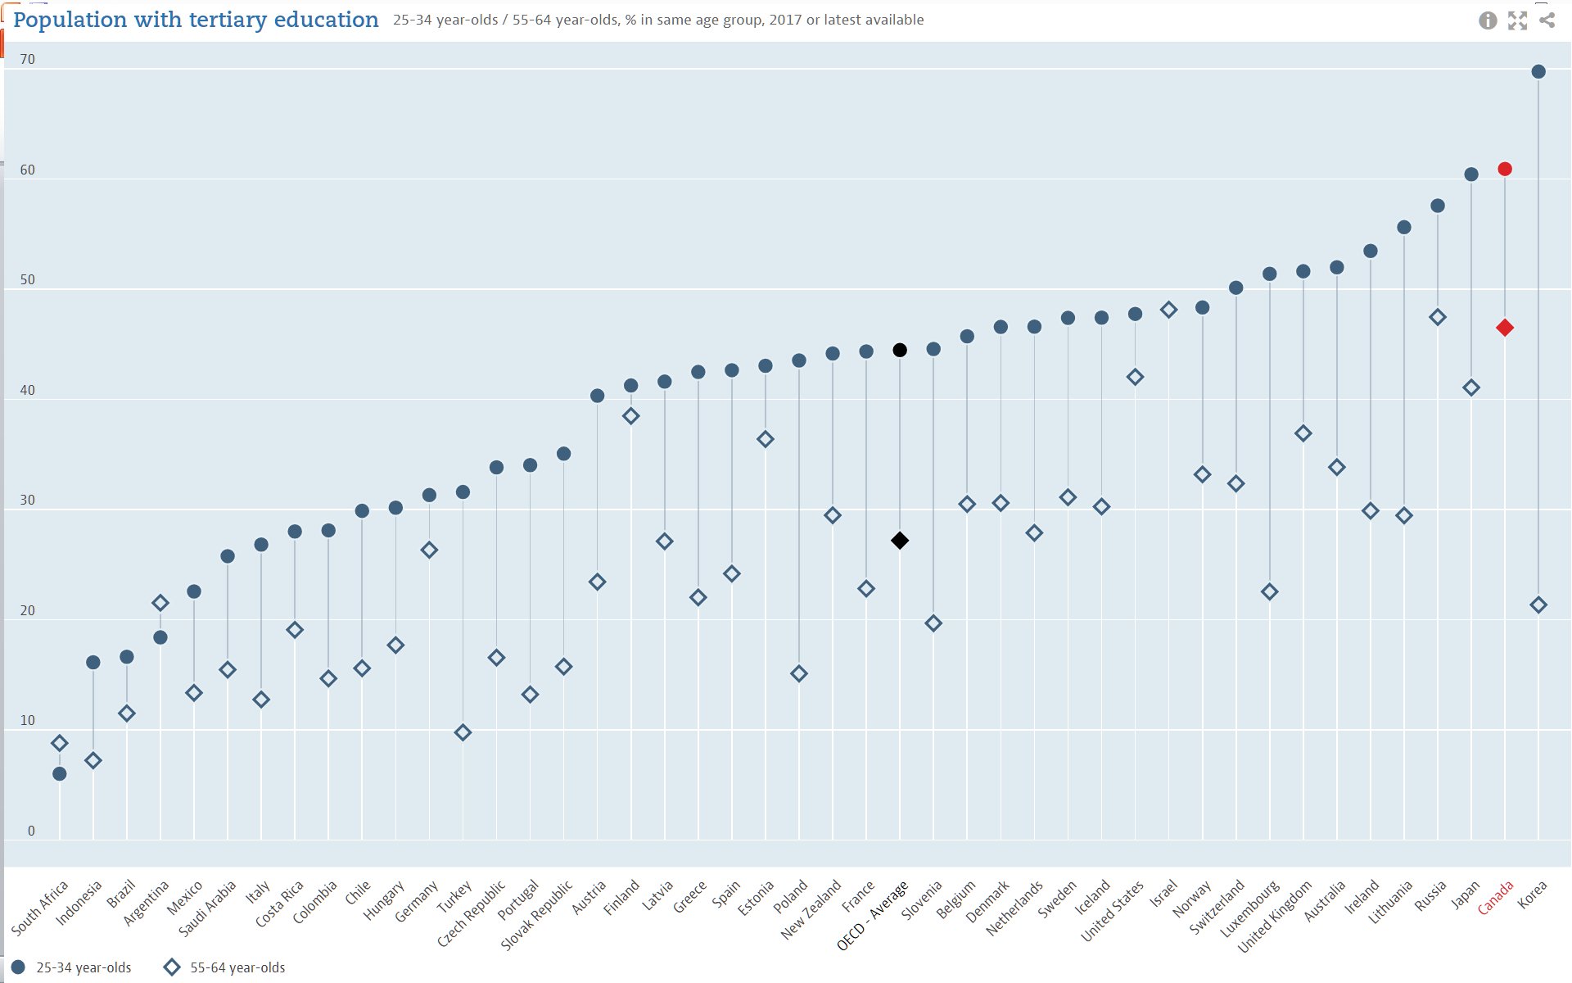
Notes:
Another statistic misinterpreted by our friends in business, government and the media who claim we need more applied diplomas/degrees and imply that the country is over-educated relative to better-performing peers. Per the FSR report: “In 2013, Canada ranked sixth for college-level graduation rates among 26 OECD comparator countries…For bachelor’s-level graduation rates, Canada ranked 15th among 29 comparator OECD countries…Canada’s performance was lower still for doctoral-level graduation rates where, in 2013, Canada ranked 22nd among 35 OECD countries, falling behind many peer nations with strong records of research productivity.”
By 2017, nothing had changed (OECD country report): “In 2016, 61% of 25-34 year-old Canadians held a tertiary qualification, the highest share of all OECD countries after Korea (70%). However, the share of 25-34 year-olds who had completed a master’s or doctoral degree is below the OECD average.”

Slide 18
BASIC RESEARCH: THE HQP ASSEMBLY LINE
Academic research is at the tip of “icebergs of knowledge”
Hegelian post-structuralism in …
Reproductive behaviour of….
Oscillations of solar neutrinos…
Professors
Post-Docs
PhDs
Master’s
Undergrads
Management of large teams
Lessons of history
Genomics
Analysis of complex texts
Biochemistry
Ultra hi-speed computing
Research skills
Data analysis
Hi-precision engineering
Written communication
Advanced instrumentation
Foreign field work
Math & Stats
Logic
Scientific method
EQUIPPED FOR A LIFETIME OF APPLICATION
Notes:
Slide courtesy of Dr Peter Nicholson – brilliant public intellectual and tireless public servant.
My read: Canada needs to get over its fetish for ‘job-ready’ graduates and start valuing graduates from all disciplines and at all levels who will help Canadian businesses create the jobs of tomorrow.
Especially true for research-based graduate degrees that are still under-valued in Canada. A PhD is the ultimate in experiential learning!

Slide 19
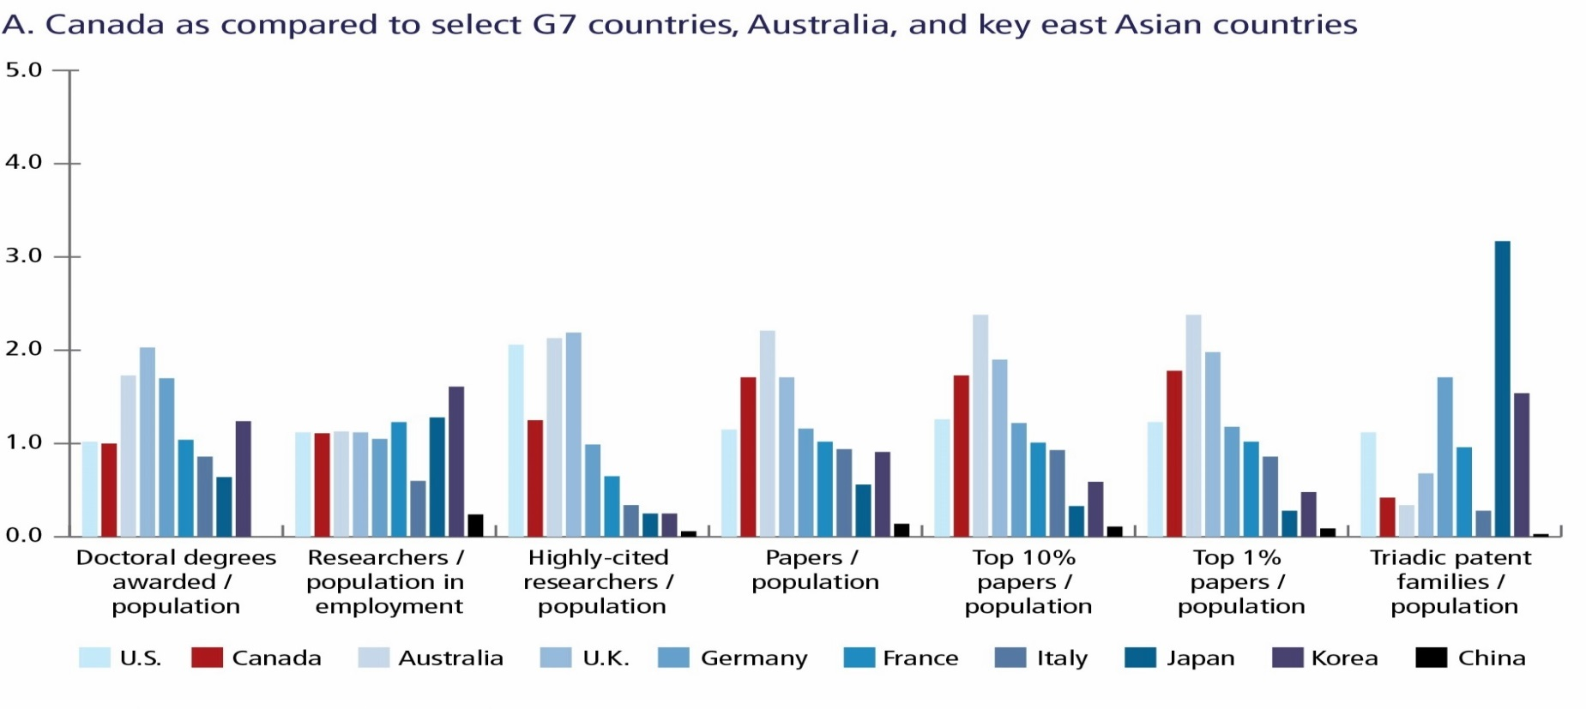
Notes:
From the FSR report: A look at how Canada stacks up internationally against G7 and other comparators. As already indicated, # of PhDs awarded per capita is lower than many peer nations. Good publication outputs, although we lag somewhat in highly-cited researchers per capita. Patents are pathetic. Universities could do better, but per slide 15, this is mostly about our lagging industry R&D activity. Other per-capita metrics look respectable.
Remember, however, that these are per-capita statistics – and bigger nations have the luxury of domination by absolute, not relative outputs. Alas, it’s a different story when we line ourselves up against smaller nations, as shown on the next slide.

Slide 20
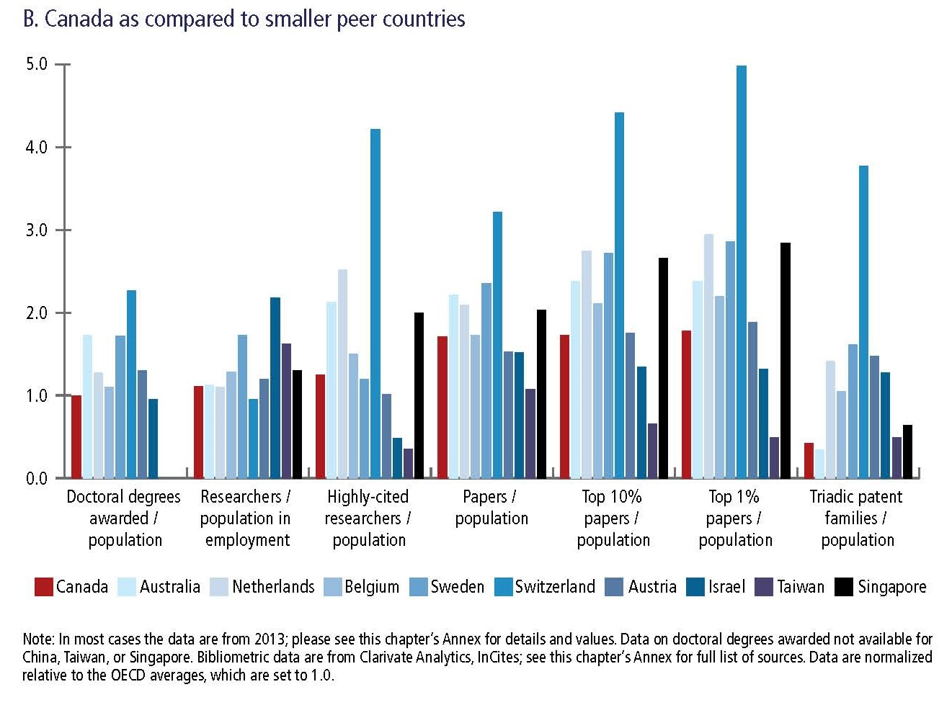
Notes:
Here, one sees pretty clear evidence of Canada’s lagging research capacity and performance compared to other small nations. A very sobering portrait…
Suggestion: Every time you read a federal press release about the great blossoming of R&D in Canada, please send a copy of this slide to the relevant MPs/Cabinet Ministers. Attach to it a very friendly note sincerely thanking our representatives for supporting and publicizing research. Then gently remind them that spin and anecdotage do not constitute evidence, and that one-off spending on pet projects is not a substitute for sustained strategic investment in science and scholarship.

Slide 21
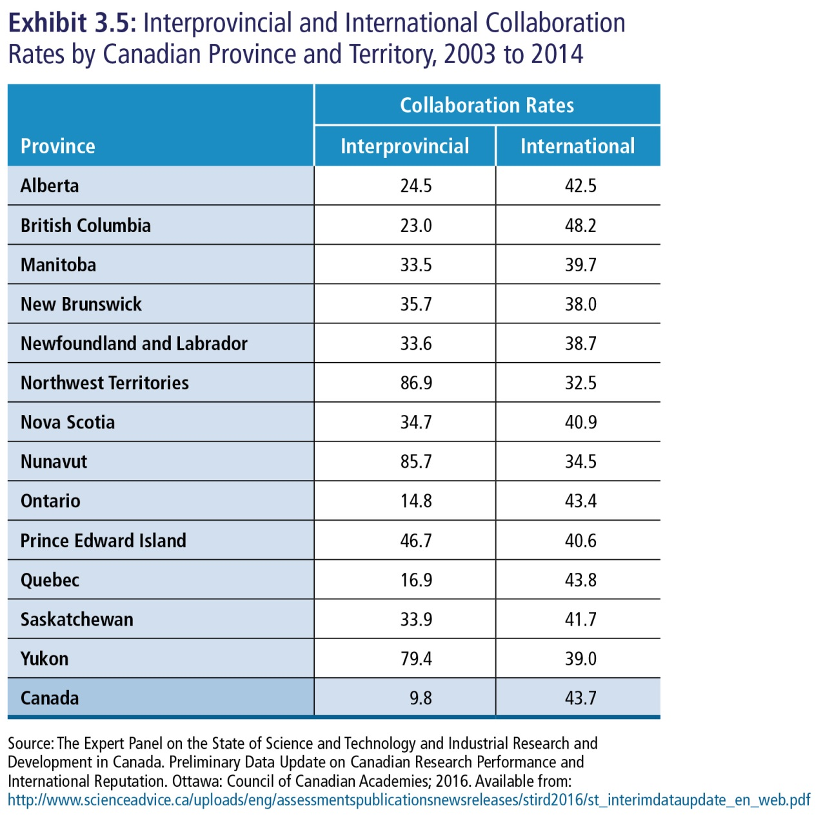
Notes:
Canada has a small population spread over a large land mass. Perhaps inevitable that many collaborations run north-to-south. Also, scholarship and science is increasingly a global enterprise – trans-continental collaborations are the norm. Nonetheless, this is sobering. Given positive economic indicators, perhaps Canadian governments and businesses will quietly decide that it is perfectly fine to continue to under-invest in R&D. But it would still make very good sense to facilitate more national collaboration. In that respect, the cancellation of the NCE program is very hard to understand.

Slide 22
“Canada’s federal research ecosystem, despite many strengths, is weakly coordinated and inconsistently evaluated, and has not had consistent oversight.”
National Advisory Council on Research and Innovation (NACRI).
Advice, coordination and strategic alignment, evaluation.
Chief Science Advisor – Vice Chair of NACRI, integrated Secretariat.
Four Agency Coordinating Board.
Canada, for a long time, has needed high-level overview and coordination of research efforts - concerns date back to the 1910s.
Current advisory systems have not had the stability and support to make a lasting contribution.
Further machinery changes may be needed if major improvements do not occur rapidly.
Notes:
Drawn from the Governance/Oversight section of the FSR report – encapsulates Chapter 4

Slide 23
GOVERNANCE – WHY THE FOCUS?
Clear evidence of weak system-level oversight:
Suboptimal coordination across the pillar agencies.
Puzzling inconsistencies in program architecture.
Uneven decision making on investments in national science facilities.
Discrepant success rates and blurred accountabilities
Proliferation of disconnected entities arising from opportunistic decisions, some inspired and some not
Importance of coordination of university and federal government science
Notes:
Self-explanatory

Slide 24
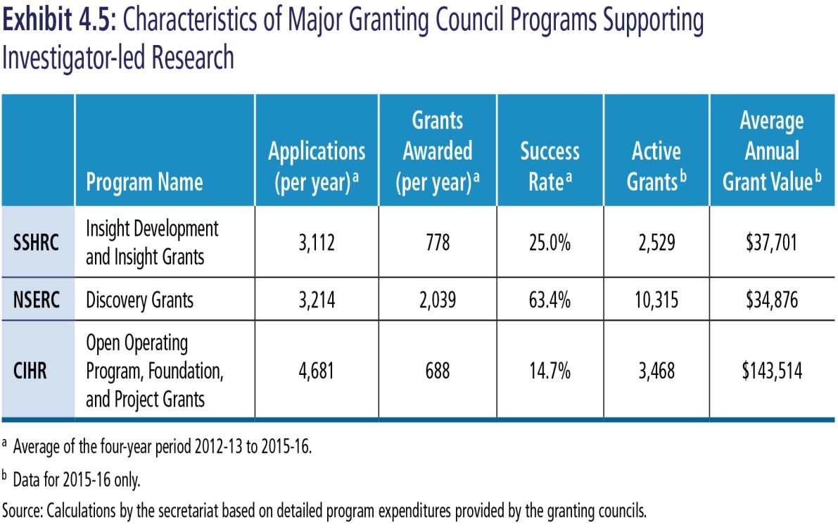
Example
Rationale:
Encouraging but piecemeal efforts to improve, highly dependent on preferences of agency presidents.
Need to prioritize cross-cutting issues related to: early career researchers, equity and diversity, indigenous scholars and research, peer review.
Notes:
Self-explanatory

Slide 25
Coordination and Harmonization
Recommendation 4.10
The Ministers of Science and Health should mandate the formation of a formal coordinating board for CFI, CIHR, SSHRC, and NSERC, chaired by the CSA. The membership of the new Four Agency Coordinating Board would include the four agency heads, departmental officials, and external experts. Reporting to the Ministers of Science and Health, the Coordinating Board would expeditiously determine and implement avenues for harmonization, collaboration, and coordination of programs, peer review procedures, and administration.
Recommendation 4.11
The Government of Canada should undertake a comprehensive review to modernize and, where possible, harmonize the legislation for the four agencies that support extramural research. The review would clarify accountabilities and selection processes for agency governing bodies and presidents, promote good governance and exemplary peer review practices, and give priority to inter-agency collaboration and coordination.
Notes:
From the FSR report – self-explanatory.
Action taken on 4.10 and related recommendations about the role of a coordinating board/committee.
No action thus far on 4.11. This is a concern because CIHR’s mandate is both staggeringly broad and detailed, while the other two councils have generic mandates with lots of maneuvering room.

Slide 26
Four Agency Coordinating Board 1
5.2 … develop and harmonize funding strategies across the agencies, using a lifecycle approach that balances the needs and prospects of researchers at different stages of their careers.
5.3 … create a mechanism for harmonization as well as continuous oversight and improvement of peer review practices across the three councils and CFI.
5.4 … develop consistent and coordinated policies to achieve better equity and diversity outcomes in the allocation of research funding while sustaining excellence as the key decision-making criterion. This priority intersects efforts to improve peer review practices and requires a multipronged approach.
5.6 … examine best practices in supporting early career researchers, augment their support of them consistently across disciplines, and track and report publicly on the outcomes.
Notes:
Self-explanatory. Encouragingly, all more or less covered in the mandate of the new coordinating body created by the Government!

Slide 27
Four Agency Coordinating Board 2
5.7 … collaborate in developing a comprehensive strategic plan to promote and provide long-term support for Indigenous research, with the goal of enhancing research and training by and with Indigenous researchers and communities. The plan should be guided by the Truth and Reconciliation Commission’s recommendations on research as a key resource.
6.4 … develop multi-agency strategies to support international research collaborations and modify existing funding programs so as to strengthen international partnerships.
6.5 …develop strategies to encourage, facilitate, evaluate, and support multidisciplinary research.
6.6 … mandate the granting councils to encourage and better support high-risk research with the potential for high impact
6.7 …mandate the granting councils to arrive at a joint mechanism to ensure that funds and rapid review mechanisms are available for response to fast-breaking issues.
Notes:
Self-explanatory. As above.

Slide 28
CRCC
Mandated to achieve greater harmonization, integration and coordination of programs and policies and to address issues of common concern to the granting agencies and the CFI
Developing innovative programming across the agencies to support international, interdisciplinary, fast-breaking and higher-risk research that generates new knowledge.
Building Canadian capacity to identify and respond to emerging areas of research.
Removing barriers faced by under-represented groups to ensure equitable access across the granting agencies, and establish Canada as a world leader in EDI in academia.
Developing, in partnership with Indigenous communities, an interdisciplinary Indigenous research and research training model that contributes to reconciliation.
Establishing Canada as a world leader in supporting the development of talent throughout the research career life cycle.
Notes:
Mandate of new Canada Research Coordinating Committee shown. Tight alignment with all the relevant recommendations of the FSR Panel. Unfortunately the Government did not follow our advice on two scores:
FSR Panel recommended that the Chief Science Advisor should be chair of this body. CSA is ex-officio, not chair. The rotation of the chair among Granting Council presidents is a weak governance and accountability structure.
We recommended inclusion of “external experts” on this body. Specifically, on p72, we said “External members would be distinguished individuals with an understanding of the extramural research ecosystem and deep experience with frontline research issues”. Didn’t happen.

Slide 29
Tri-Agency Fund Proposal (per CRCC)
Budget 2018 allocated $275 million over five years, with $65 million per year ongoing, for a tri-agency fund to support international, interdisciplinary, fast-breaking and high-risk research. The CRCC proposed a draft program design that featured two funding mechanisms and a modified review process.
The first funding mechanism, designed to provide seed funding and support large projects, would be open to interdisciplinary and high-risk projects in any area, with international collaborations strongly encouraged.
The second funding mechanism would be designed to respond rapidly to urgent national challenges and time-sensitive opportunities for international collaboration.
Notes:
Slow launch of this fund, with long consultation processes, and varied purposes/objectives attached to this initiative. Due credit, however, to SSHRC president Ted Hewitt as chair and to CRCC colleagues for getting these competitions launched. Now we need a serious ongoing evaluation of how this is all working.

Slide 30
We did not say that NCEs should be defunded…
6.2 The Government of Canada should direct the Four Agency Coordinating Board to amend the terms of the NCE program so as to include the fostering of collaborative multi-centre strength in basic research in all disciplines.
Notes:
Page 164 of the FSR Report is clear that the NCEs and CFREFs offer two models for creating multi-institutional networks. It calls for a review and revision of the terms of the NCE program, and a clear-eyed external review of the benefits and opportunity costs of the CFREF program. Instead, the Government of Canada cancelled the NCEs, and implied that the new Tri-Agency Fund somehow fulfills the national networking objectives we believed were essential to generate made-in-Canada critical mass in specific areas of inquiry (see slide 21). A regrettable decision that also nets out as a reduction in the new investments made in Budget 2018.

Slide 31
NACRI - CSI
Recommendation 4.1 The Government of Canada, by an Act of Parliament, should create a new National Advisory Council on Research and Innovation (NACRI) to provide broad oversight of the federal research and innovation ecosystems.
Recommendation 4.2 The Science, Technology and Innovation Council should be wound down as NACRI is established.
Recommendation 4.3 NACRI should have 12 to 15 members, appointed through Orders in Council, comprising distinguished scientists and scholars from a range of disciplines as well as seasoned innovators with strong leadership and public service records from the business realm and civil society. Domestic members should be drawn from across Canada and reflect the nation’s diversity and regions.
Recommendation 4.4 An external member should hold the Chair of NACRI with the CSA serving as Vice Chair. NACRI should be supported by a dedicated secretariat working within the larger expert team supporting the CSA.
Notes:
A key part of rebuilding the ecosystem is putting in place an oversight body with a legislated mandate to do independent public reporting. Hence, the recommendation above.

Slide 32
NACRI CSI 2
Recommendation 4.5 The Privy Council Office, working with departmental officials and the newly appointed CSA, should examine mechanisms to achieve improved whole-of-government coordination and collaboration for intramural research and evidence-based policy-making.
Recommendation 4.6 As a council of senior volunteers with a broad mandate of national importance, NACRI should have a publicly acknowledged working connection to the Prime Minister/PMO, parallel to that established for the CSA.NACRI should report to and interact most directly with both the Minister of Science and the Minister responsible for Innovation and Economic Development. It should also have open channels of communication with the Minister of Health and other ministers of key departments involved in intramural and extramural research.
Recommendation 4.7 A Special Standing Committee on Major Research Facilities should be convened by the CSA and report regularly to NACRI. The committee would advise NACRI and the Government of Canada on coordination and oversight for the life cycle of federally supported MRFs.
Notes:
Further elaboration, self-explanatory.

Slide 33
Notes:
Government promised action on a NACRI type body, but dawdled. In late 2018 the Royal Society increased pressure on the G of C by publishing a Position Paper on Sustainable Science Advice in Canada.
See www.rsc-src.ca/en/nextsteps.

Slide 34
RSC Next Steps for sustainable science advice for Canada 2018-19
It is now urgent that attention be focused on closing the inside-outside gap through creation of explicit pathways that enable and facilitate external science advice. Specifically, the RSC suggests there are two crucial next steps:
….Canada’s Chief Science Advisor be formally recognized as the Government’s key interlocutor connecting external science and government, and that this role be embodied in legislation…
…. the Government of Canada act expeditiously to create a high-level science and technology advisory committee, and that this committee be embodied in legislation. We further recommend that the CSA serve as co-chair (or chair) with an external co-chair (or vice-chair) selected from among the appointees by the Government of Canada…
Notes:
Self-explanatory. RSC paper also highlighted adverse history in Canada on multiple levels. Canada is the only G7 nation that has created and then abolished a national science advisor position. Since reinstated by the current Government.
Canada also has gutted/abolished various advisory bodies, and created advisory machinery (Council of Canadian Academies) that doesn’t actually give advice. CCA is formally constrained to generate an evidence base and suggest policy implications but not to explore options let alone recommend a way forward. A
massive and embarrassing contrast with the US National Academies…

Slide 35
Council on Science & Innovation
…mandated to: provide evidence-based analysis and policy advice to the Ministers on complex issues…provide a “sounding board” for the Ministers on short-term and/or urgent issues; and publicly report on science and innovation issues of importance to the Government of Canada and to Canadian citizens.
… encompass the full range of disciplines…and cover the breadth of activity from fundamental research through applied research to successful commercialization of product/process innovations and the application of new insights to societal challenges… …appointed jointly by the Ministers…composed of a Chairperson and 11 other members drawn from the scientific and research community, the private sector, and civil society
…the Chief Science Advisor will serve as ex-officio Vice-Chair, and the Deputy Minister of ISED and Deputy Minister of Health will serve as ex-officio members
… ex-officio appointments and/or cross-appointments with related bodies may be made at Ministerial discretion to facilitate an integrated, holistic approach to science and innovation governance.
Notes:
Government responded in January 2019 by announcing the mandate of the new oversight body: the Council on Science and Innovation. Called for applications to serve on the Council. Closely tracks the FSR advice. Welcome initiative. No legislative provisions, but at least public reporting is stipulated in the mandate.
Three trailing issues: A. How to deal with appointees who have obvious COI given evaluative role of CSI w.r.t. 3rd-party funding proposals/renewals? B. Will front-line researchers and entrepreneurs be included from diverse backgrounds/career stages? C. Will cronyism see the usual suspects and retreads predominate, or will there be new blood?

Slide 36
FSR observations about the FPT interplay
Very limited FPT interaction and shared strategizing among senior officials on the science and innovation files
Imbalances of financial support for research from federal, provincial and institutional sources
Specific friction points: e.g. sharing of F&A (indirect) costs, federal programs requiring for PT match funding without collaborative adjudication
Weak alignment on shared challenges such as research infrastructure/infostructure
Absence of a shared vision and national action plan for developing research-intensive talent
Notes:
Self-explanatory from FSR report.
Alas, FPT interactions getting steadily worse with political polarization and divergence of FP views on economic and social issues. PT commitment to independent science/research uneven outside of Quebec. Concerns growing in Ontario where a newly-appointed and distinguished Chief Scientist was dismissed by the new government, and research program cuts are now occurring.

Slide 37
FPT Recommendations
4.8 …Ongoing interactions and annual in-person meetings should be established to strengthen collaborative research relationships among federal, provincial, and territorial departments with major intramural or extramural research commitments. The CSA, with advice from NACRI, should take the lead in promoting a shared agenda on matters of national concern, such as human resource planning to strengthen research and innovation across Canada.
4.9 …Government of Canada should propose and initiate planning for a First Ministers’ Conference on Research Excellence in 2017. The conference would celebrate and cement a shared commitment to global leadership in science and scholarly inquiry as part of Canada’s sesquicentennial celebrations.
Notes:
Recommendation 4.8 remains important and received negligible attention. Now, the window for FPT collaboration has narrowed dramatically. A real shame given the number of issues where FPT collaboration on R&D and human resource planning/HQP would be invaluable to the future of Canada.
Recommendation 4.9 was time-limited and reflected misplaced sesquicentennial-induced optimism. Not even Canada’s 150th birthday could get federal Ministers and bureaucrats to seek common ground with their provincial counterparts on key R&D issues. Oh, Canada!

Slide 38
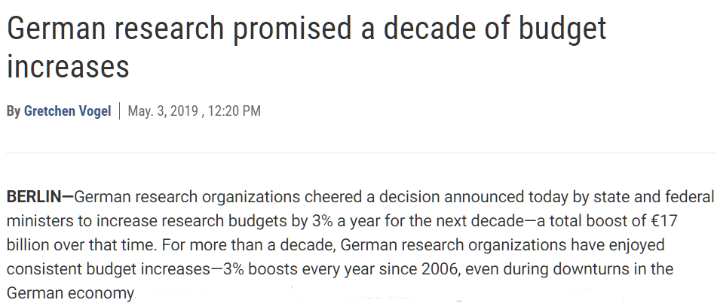
Notes:
A painful contrast on the FPT front between Canada and Germany. Germany boosted research spending by 3% a year for a dozen years starting in 2006 – the period when Canada really started to lose ground in support for independent research. The German increases reflected a funding partnership between the federal government and the 16 German states (13 regions, 3 city-states).
Now that partnership has been renewed for another decade!

Slide 39
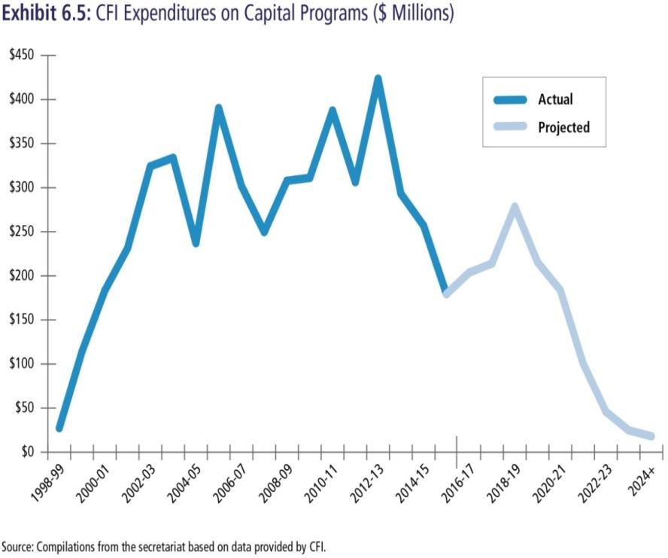
Infrastructure
Related recommendations:
Stabilize CFI funding
Digital research infrastructure
MSIs/Infrastructure operating costs
Rationale:
Saw-tooth pattern impedes planning and coordination
MSI matching fund requirement is challenging
Operating cost difficulties for smaller capital awards
Notes:
As outlined in the FSR report, CFI has not had consistent funding for many years. We recommended advance planning to secure more consistent one-time funding within a narrower band of dollars/time-frames. Did not recommend base funding for CFI. Understood a steadier version of the status quo was a execution challenge for the federal public service, but feared base $ for CFI would be set-off against other $ such as operating funds.
We also indicated that giving CFI A-base funding should trigger a review of its governance and an end to its stand-alone status. Could lead to improved coordination.

Slide 40
Infra- and Info-Structure
6.8 … provide CFI with a stable annual budget scaled at minimum to its recent annual outlays.
6.9 … consolidate the organizations that provide digital research infrastructure, starting with a merger of Compute Canada and CANARIE. It should provide the new organization with long-term funding and a mandate to lead in developing a national DRI strategy.
6.10 … mandate and fund CFI to increase its share of the matching ratio for national-scale major research facilities from 40 to 60 per cent.
6.11 … mandate and fund CFI to meet the special operating needs of individual researchers with small capital awards
Notes:
Recommendations. Self-explanatory.

Slide 41
Info- and Infrastructure
CFI ongoing base by 2023-24 (Base) = $462M/yr
$160M over 5 years for CFI’s Major Science Initiatives Fund
$572.5M over 5 years, ongoing base = $52M/yr for Digital Research Infrastructure Strategy
Notes:
CFI got full A-base funding, and as feared, the Government fell well short on commitments to open operating grants. Nonetheless, very good to see CFI on a stable footing! No hint so far, alas, of addressing CFI’s governance. Should be aligned with other councils, and brought fully under CRCC oversight.
Major Science $ = a good step, as recommended.
Massive commitment to digital research infrastructure. Combined relevant agencies as recommended, but ignored advice to complete a scoping exercise assessment before deciding on a quantum of $.
Bottom line: Infra-/Info-structure feasted, while operating grants and personnel awards were short-changed.

Slide 42
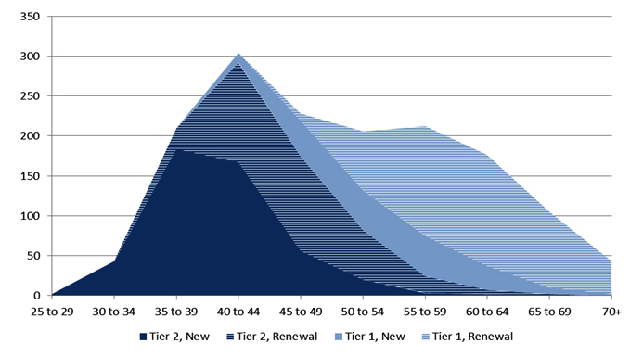
Demographics of CRCs (2015)…
Notes:
Turning now to funding recommendations related to personnel. Demographics of Canada Research Chairs (CRCs) shown. CRCs started in 2000, and now features a preponderance of aging Baby Boomers. Limited funding flowing to early career researchers [ECRs].
In consultations, some colleagues wondered if we needed a set of “Tier 1.5” CRCs, to avoid the mid-career ‘valley of death’, i.e. adjust eligibility criteria so ‘senior 2s’ and ‘junior 1s’ overlap for smooth transition. This graphic and ongoing ECR feedback suggest that reinstatement of some personnel awards for new investigators may also be a good idea.

Slide 43
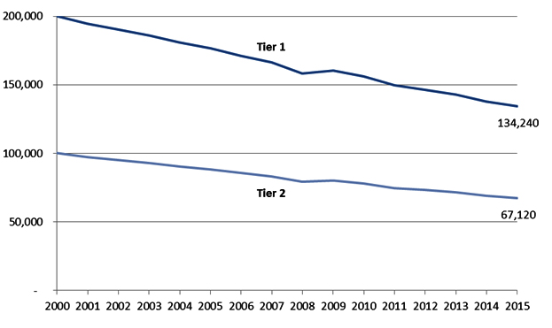
Declining Real Value of CRCs
Notes:
Decline in the real value of the CRCs. Self-explanatory. Tier 1 chairs valued at $200K per annum x 7 years renewable. Tier 2 chairs valued at $100K per annum x 5 years renewable once only.
There’s been no adjustment to the value of these awards since inception, with the result that inflation has eroded the impact of what was once a flagship program.
Governments unfortunately have preferred to make a splash with a small number of chairs to recruit ‘superstars’ from abroad, hence the Canada Excellence Research Chairs under the previous government, now slightly adjusted and rebranded as Canada 150 Chairs.

Slide 44
PERSONNEL
Rationale:
Strategic federal investments can advance the overall research enterprise by developing and/or attracting, and then supporting, the outstanding personnel needed to achieve excellence.
Real award values for CRC have diminished over time, students/trainees are underfunded.
The current mix of graduate and post-graduate awards vary considerably by value, duration, and international portability.
Notes:
See table above. Reinvestment in the CRCs recommended to mitigate the effects of inflation. Recommended restoration of funding taken from the program by the Harper government due to vacant chairs that were never filled. (The latter situation was overwhelmingly due to a remediable issue -- poor management by both the TC secretariat and institutions of the logistics of chair turnover. )
Panel also found a somewhat chaotic situation with variable and often under-sized personnel awards for graduate students and post-doctoral fellows. Recommended a review and reworking of the current student and PDF funds, along with new investments.

Slide 45
Personnel Recommendations
7.1 … direct the Four Agency Coordinating Board to oversee a tri-council process to reinvigorate and harmonize scholarship and fellowship programs, and rationalize and optimize the use of current awards to attract international talent.
7.2 … renew the CRC program on a strategic basis in three stages:
1. Restore funding to 2012 levels, upon development of a plan by the granting councils and Chairs Secretariat to allocate the new Chairs asymmetrically in favour of Tier 2 Chairs, and increase the uptake of available funds through improved logistics in managing numbers and reduced delays in awarding Chairs;
2. Direct the granting councils to cap the number of renewals of Tier 1 Chairs and, in concert with universities and CFI, develop a plan to reinvigorate international recruitment and retention, for review by NACRI and approval by the government; and
3. On approval of that plan, adjust the value of the CRCs to account for their loss in value due to inflation since 2000.
Notes:
Excerpts from the personnel recommendations in the FSR report are shown above for reference.
Self-explanatory.

Slide 46
CRCs
…Budget 2018 proposes a new investment of $210 million over five years, starting in 2018–19, with $50 million per year ongoing, for the Canada Research Chairs Program. The purpose of this investment will be to better support early-career researchers, while increasing diversity among nominated researchers, including increasing the number of women who are nominated for Canada Research Chairs. This funding …could result in, for example, 250 additional Chairs for early-career researchers by 2020–21, and a sizeable increase in funding provided to early-career researchers.
$50M vs $140M …(‘further work’ promised on grad students and post-docs)
Notes:
The steady-state amount committed to CRCs in Budget 2018 is shown as compared to the recommended amount. Harper era cut reversed. Great to see a new tranche of Tier 2 Chairs – FSR Panel specifically recommended selectively augmenting their numbers.
Alas, no commitment to refinance/refurbish the Tier 1 Chairs – a seriously short-sighted decision given the existing scale of investment and Canadian talent holding those senior awards.
No funds allocated to grad students and post-docs. Fortunately, the issue was acknowledged and deferred for “further work”.
Serious shortfall here…

Slide 47
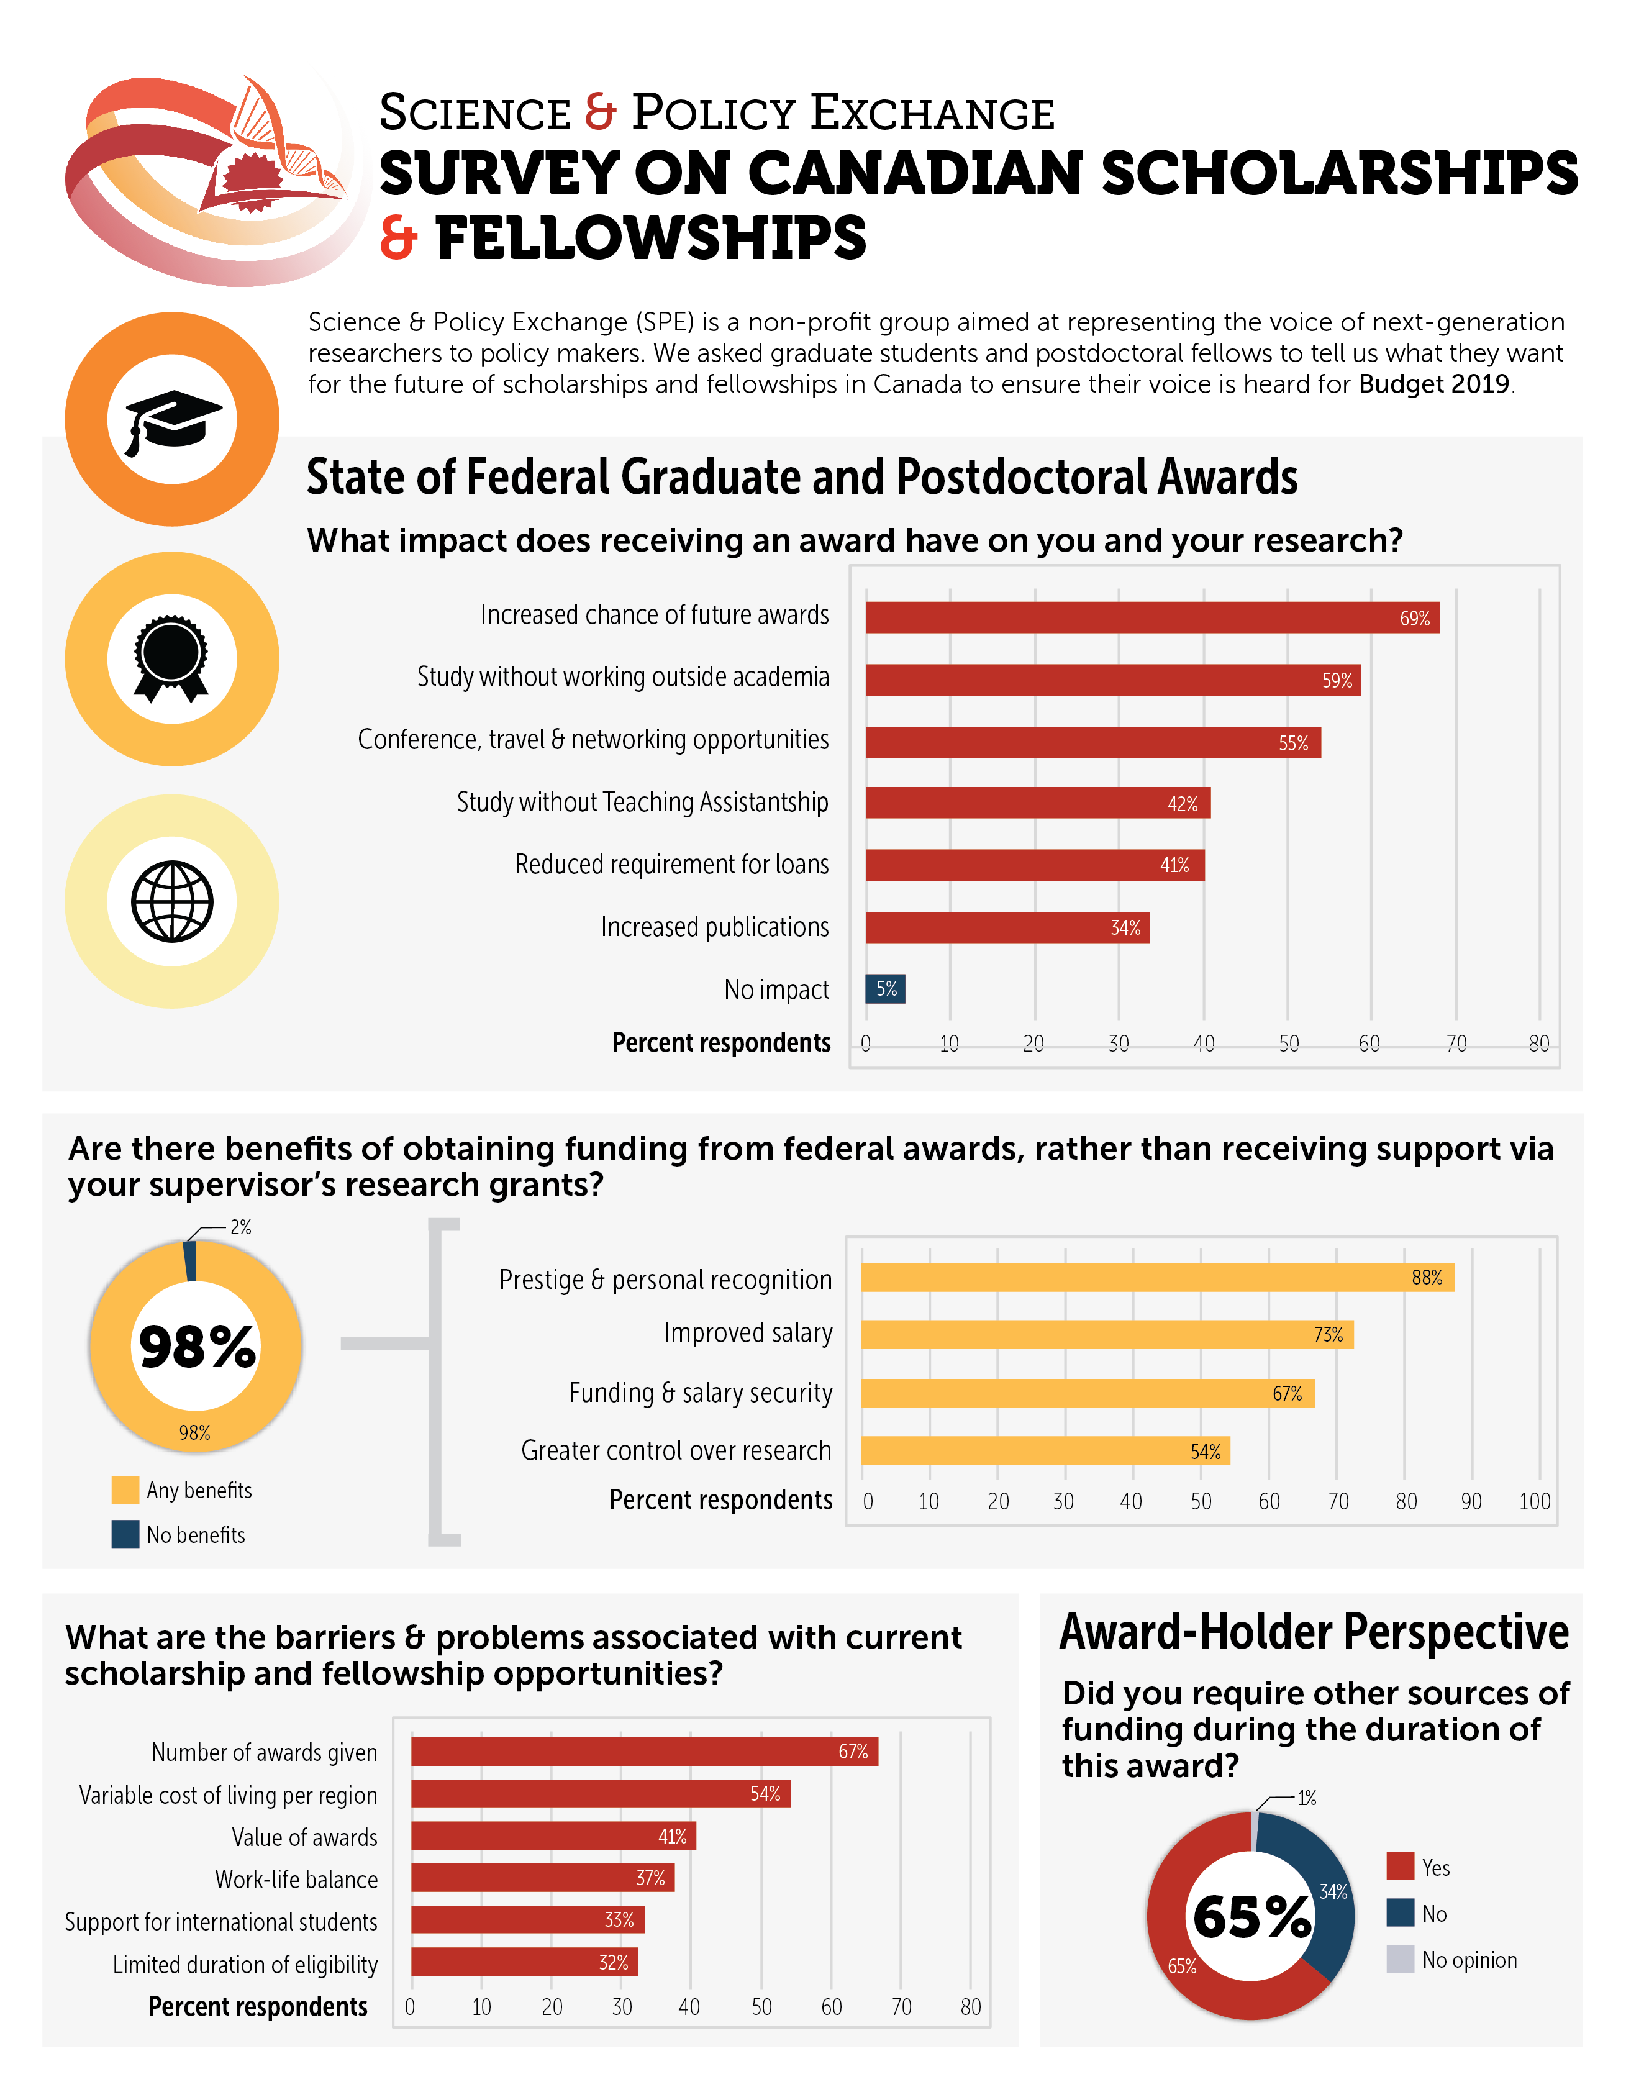
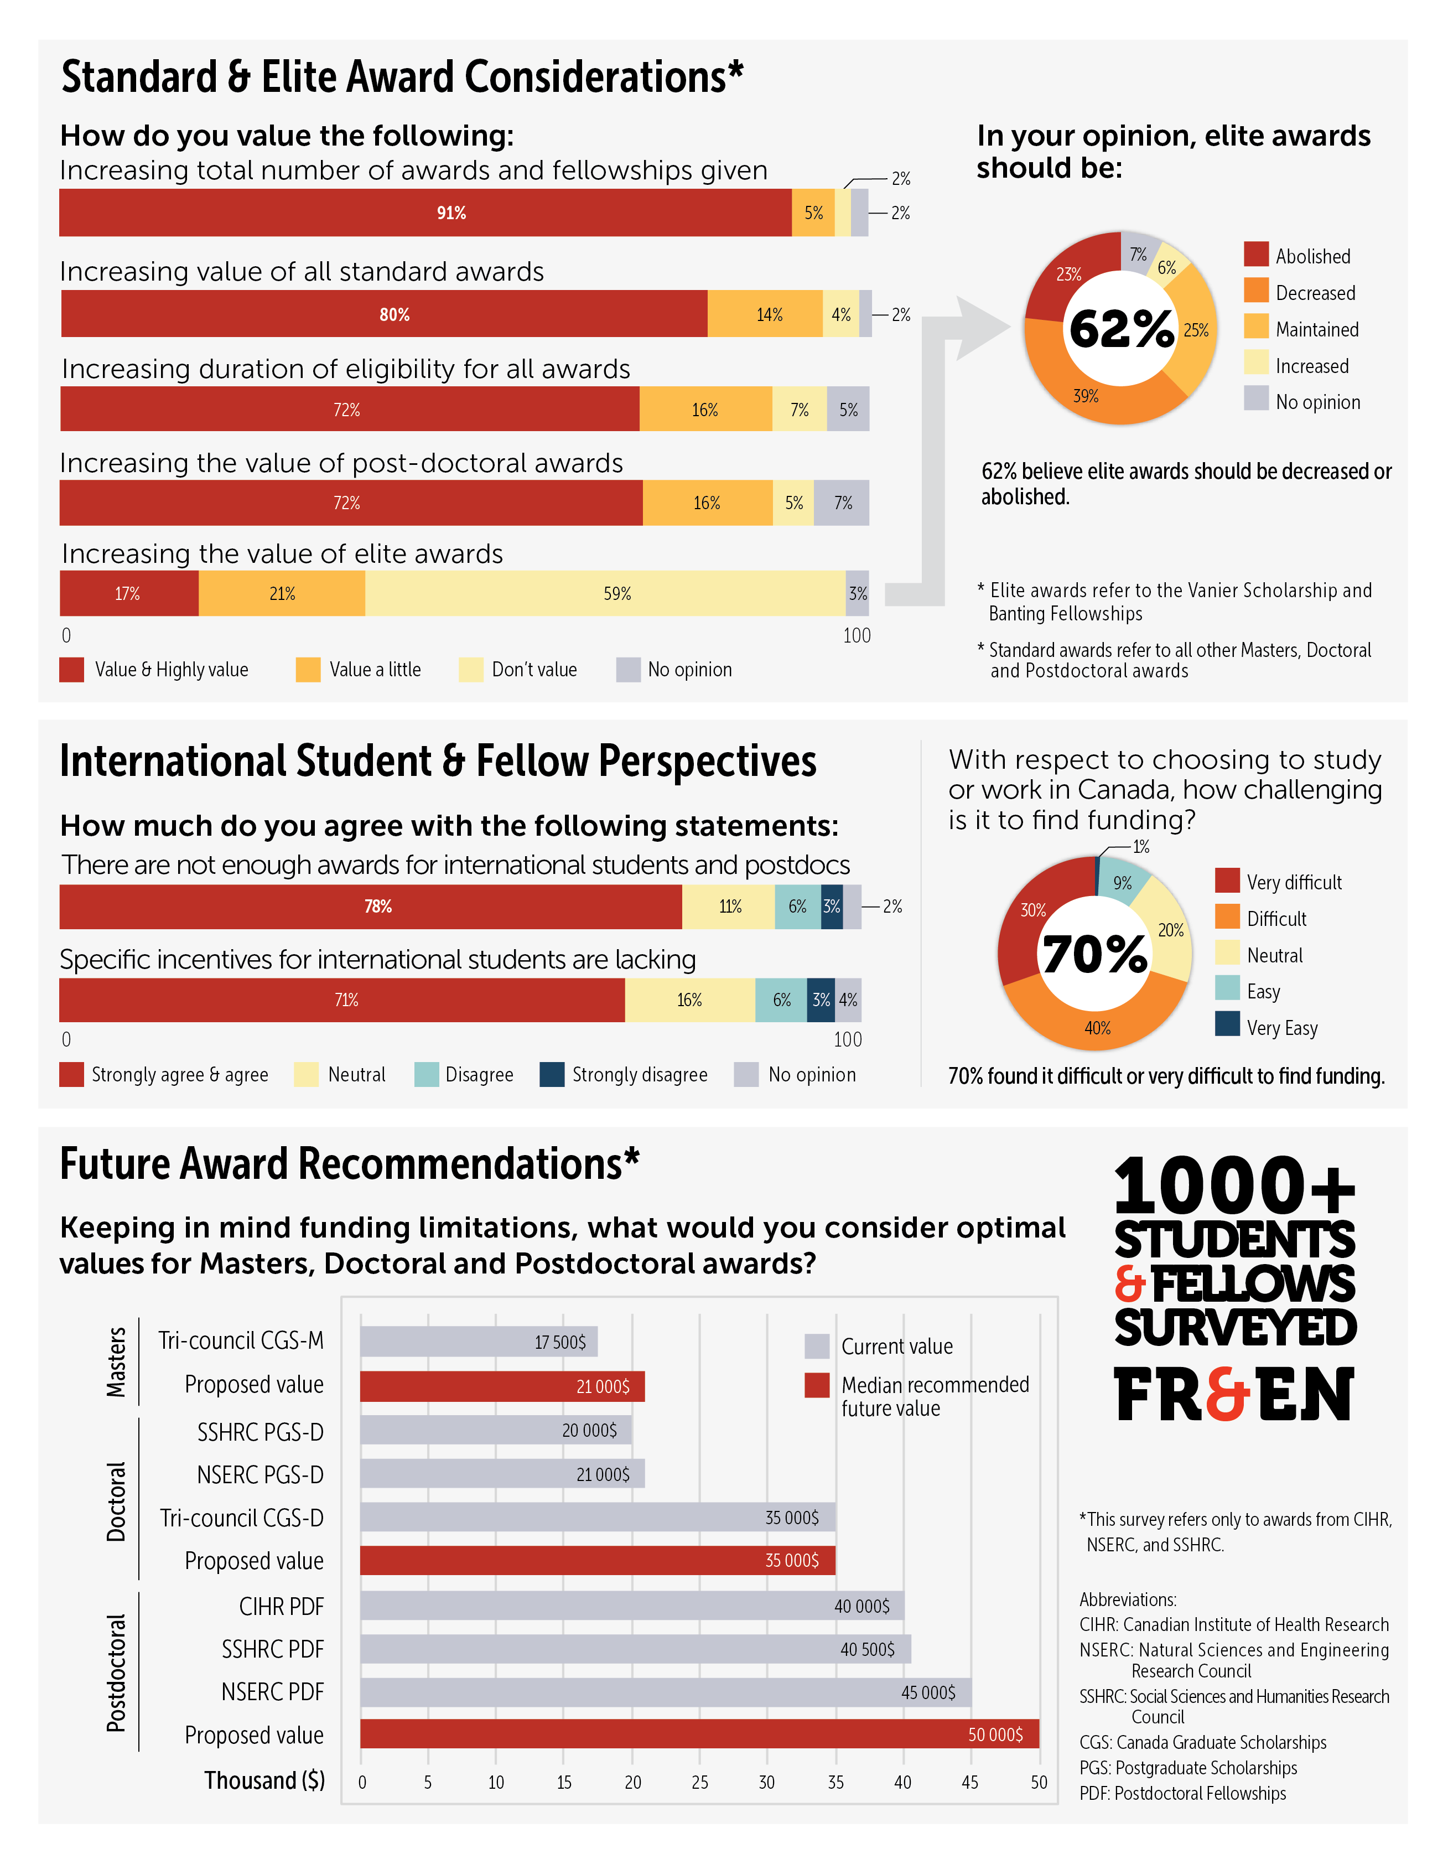
Notes:
Survey undertaken by Science & Policy Exchange sp-exchange.ca = a Montreal-based non-profit – “Our mission is to help bridge the gap between academia, industry, and government to inspire evidence-based policy-making.” Founded and led by PhD students and post-docs. Surveyed grad students and post-docs to strengthen the case for follow-through on Budget 2018’s placeholder with new $ in Budget 2019.
Lobbied actively. Wrote strong op-ed in the Globe. See: https://www.theglobeandmail.com/opinion/article-to-cultivate-a-new-culture-of-science-canada-must-invest-in-research/

Slide 48
Budget 2019 Grad Students/PDFs
… proposes to provide a total of $37.4 million over five years, starting in 2019–20, and $8.6 million per year ongoing, to the federal granting councils, to expand parental leave coverage from six months to 12 months for students and postdoctoral fellows who receive granting council funding.
… proposes to provide $114 million over five years, starting in 2019–20, with $26.5 million per year ongoing, to the federal granting councils—the Natural Sciences and Engineering Research Council, the Canadian Institutes of Health Research and the Social Sciences and Humanities Research Council—to create 500 more master’s level scholarship awards annually and 167 more three-year doctoral scholarship awards annually through the Canada Graduate Scholarship program.
Notes:
Finance responded in Budget 2019. Provided $26.5M per annum in ongoing funding for graduate students across the three granting councils. Commitment included a very smart provision for parental leave -- Chapeau! Alas, no allocation to post-doctoral fellows and no revision to the award levels.
Recommended tri-council work needed to review and streamline the existing suite of graduate scholarships and post-doctoral fellowships has still not been done.
Still well short of total investments ecommended by FSR for grad students and PDFs…

Slide 49
Success Rates and/or Grant Levels are very low and are discouraging participation in research by the younger generation, thereby also reducing diversity.
Notes:
Slide courtesy of Professor Emeritus Arthur B. McDonald.
Unmarked exhibit used in the FSR report to illustrate the sharp differences that have emerged in approval rates and grant-making practices across the three granting councils [TC] w.r.t. Open Competitions. Also shows low success rates at SSHRC and especially CIHR, and low value of annual grants, especially relevant for NSERC.
The TC equity, diversity and inclusion initiatives align with FSR recommendations and are very good news. However, they will all be sharply undercut if the government does not flow enough $ to give the next generation of researchers a fair shot at launching their careers!

Slide 50
DIRECT PROJECT FUNDING
“The panel’s single most important recommendation is that the federal government should rapidly increase its investment in independent investigator-led research.”
$485 million base increase over 4 years + Tranches for international collaboration, multidisciplinary work, high-risk ventures, and projects requiring a rapid response
Moves balance of funding back toward a 70:30 ratio, and addresses current gaps
Notes:
Per the previous slide, the FSR Panel paid close attention to the shortfall in approval rates and levels of funding for independent operating grants. $405M per year recommended as the steady-state target for the open competitions.
Another $80M per year in steady state recommended for specialized competitions addressing: international collaborative opportunities; high-risk/high-reward projects; trans-disciplinary initiatives; and public interest matters requiring rapid and targeted research responses.

Slide 51
Operating Grant Boost
The Government proposes to invest $925 million over five years, starting in 2018–19, and $235 million per year ongoing:
• $354.7 million over five years ($90.1 million per year ongoing) to the
Natural Sciences and Engineering Research Council (NSERC).
• $354.7 million over five years ($90.1 million per year ongoing) to the Canadian Institutes of Health Research (CIHR).
• $215.5 million over five years ($54.8 million per year ongoing) to the Social Sciences and Humanities Research Council (SSHRC). $235M/$405M
Notes:
As shown, there was a very worrisome shortfall in the steady-state allocation to open competitive grants. $235M versus $405M recommended by the FSR Panel in what we repeatedly flagged as our single most important message. 58% of amount proposed despite careful (and conservative) benchmarking by FSR panel/secretariat.
Furthermore, rather than speeding up pace to reach steady-state faster at a lower level, Government went with a five year rather than four year plan as recommended in the FSR Report.

Slide 52
Steady State – Unsteady Status
$235M vs $405M for the Three Councils
$65M vs $80M “to accelerate Canada’s transition to a more modern approach to research”
Total - $300M/$485M = 61.85%
Slow rise, lower endpoint: trouble now and later.
Notes:
Budget 2018 was proportionately more generous with the four specialized competitions – 81% of recommended levels – because they were bundled together and proclaimed to be “a more modern approach to research”. Nonsensical. Pretending that an earmarked seed-funding model should supplant rather than complement prevailing open models of disciplinary and multi/inter/trans-disciplinary inquiry.
That ‘bundle’ was also used, as noted above, to justify defunding the NCEs.
Overall, the total steady-state commitment to open competitions was about 62% of the recommended amount.

Slide 53
Disciplinary distribution
5.1 NACRI should be asked to review the current allocation of funding across the granting councils…Particular attention should be paid to evidence that ongoing program changes have adversely affected the funding opportunities for scholars in the social sciences and humanities. Some movement in Budget 2018 – CSI action?
Notes:
Budget 2018 departed only slightly from the usual 40:40:20 ratio for NSERC:CIHR:SSHRC, providing $354.7M over 5 years with $90.1M ongoing to each of NSERC and CIHR, versus $215.5M over 5 years and $54.8M ongoing to SSHRC.
Split = 23.3% to SSHRC versus historical 20%. Allocation formula longer-term merits review by the CSI.
Per usual SSHRC was asked to administer the additional $65M per year of tri-council pooled funding, but that is unlikely to have much bearing on the discipline-specific allocation of funds.

Slide 54
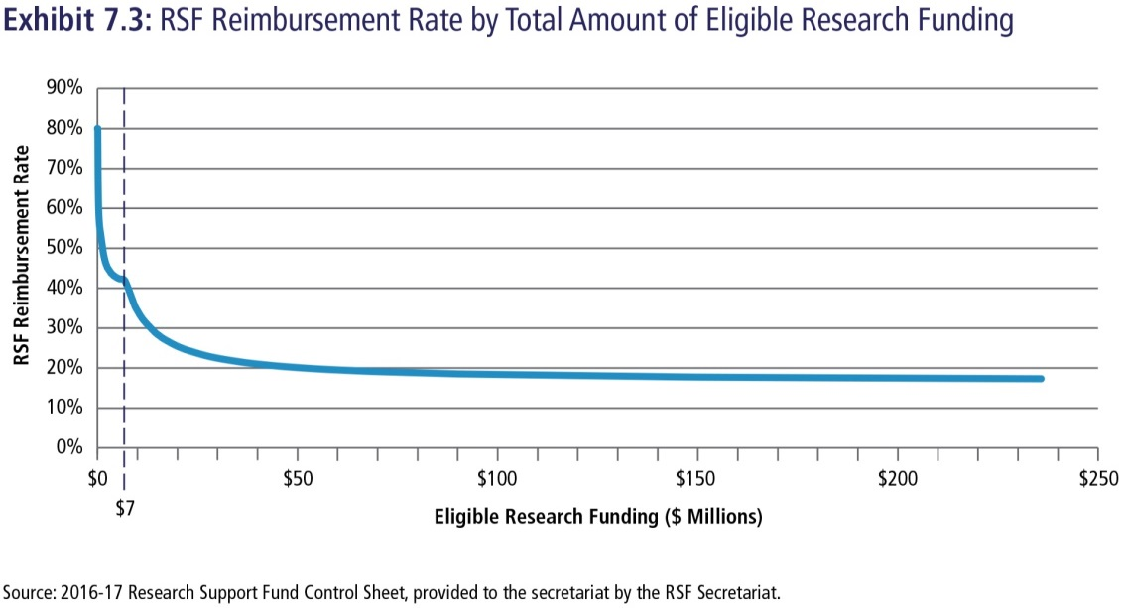
FACILITIES AND OPERATIONS
“The much larger issue is strengthening the overall institutional fabric of Canadian research.”
Current average reimbursement level at 21.6 per cent of eligible grants – very low comparatively.
F&A costs are significant: maintaining equipment, regulatory standards, computational services, managing IP, lighting, and heating, administering grants and awards.
Universities cross-subsidize research mission at expense of teaching.
Notes:
Another major shortfall occurred in what are sometimes mistermed ‘the indirect costs of research’. There is nothing indirect about these costs. They are what institutions must spend to maintain facilities and equipment, to administer research, and to deal with broad operational costs of research.
More accurately termed F&A costs in the US, i.e. "incurred for common or joint objectives and therefore cannot be identified readily and specifically with a particular sponsored project, an instructional activity, or any other institutional activity.“
The G of C contributes toward F&A costs on a sliding scale through the Research Support Fund (RSF). As shown, the scale gives much higher percentage payments to small institutions, while institutions with higher total values for operating grants get markedly lower percentages of reimbursement.

Slide 55
Facilities & Administration Costs
7.3 …gradually increase funding to the RSF until the reimbursement rate is 40 per cent for all institutions with more than $7 million per year of eligible funding. Current thresholds should be maintained to enable additional support for smaller institutions…
Notes:
Average audited F&A costs in Canadian institutions typically run over 50 cents for each direct operating dollar. The costs rise as proportionately more work is done in NSERC and CIHR disciplines. Many large institutions were receiving 20-25% as an F&A rate. The Panel recommended raising the floor for reimbursement to 40% of the value of eligible operating grants awarded to a given institution. It also recommended maintaining higher rates for small institutions because of their inherent diseconomies of scale.

Slide 56
F&A Costs/RSF/Indirect Costs
Budget 2018 - $58.8 million per year ongoing, to SSHRC, which administers the RSF program on behalf of the granting councils.
Direct increase = $300M x 20% = $60M - not even enough to cover the increase in operating grants at current rates
Notes:
Budget 2018 ignored the call for increases in the RSF to enhance the F&A reimbursement rates. The Budgeted increase was $58.8M in steady state. The corresponding increase in eligible operating funds in steady state was at least $300M, as noted earlier. $300M x 20% = $6OM – i.e. the budgeted RSF increase was not enough to cover new F&A costs even at the current rates!
It is this type of free-riding by the federal government that drives Canada’s global outlier status with unusually large institutional contributions to the HERD ratio.

Slide 57
The future of Canadian research?
Notes:
How to characterize the status quo? In a number of instances, the new operating and personnel funding provided by the Government of Canada fell well below levels recommended by the FSR Panel – a clear contrast with $ flowing to research infrastructure/tools and info-structure, or in new direct subsidies to business. Budget 2019 was understood to be a pre-election exercise with a smattering of one-offs. But as time passes, the impact of these shortfalls has caused growing unease in the research community.
Easy to be discouraged, but tangible progress has been made in oversight, coordination, strategic clarity, and funding for multiple elements in the extramural research ecosystem. There is a serious distance to go, but the research cup is still best characterized now as ‘half-full’ rather than ‘half-empty’.

Slide 58
Communications & Advocacy 2017-18
► One Voice versus Cacophony
► Broad Support with Special Emphasis, not the converse
► Avoid Redistribution: No one wins a zero sum game…
► Flip the ‘Priorities’ question upside down!
► Facts, Numbers, & Stories
► Highlight potential, be Positive – with one exception
EXCEPTION: Risk to the Next Generation…
Notes:
Some elements of the successful 2017 campaign: ‘One voice’ was pivotal in the run-up to Budget 2018.
No gaming, viz.: ‘Oh yes, we believe in research, but what we really want is this specific goody for our place/group!’
Avoid politicians’ rhetorical traps: “The pot is finite. What should I defund?” Or: “Give me one and only one priority”. Further research funding increases will be a miniscule fraction of federal spending. Their decisions to make, their consequences to take…
Facts and figures are dry. Stories are salient.
Highlight the positives and potential – but warn of the stark and continuing risks to the next generation.
.

Slide 59
Does the GoC #SupporttheReport?
It’s complicated!
Cover for unpopular decisions vs Pressure for popular decisions that chew up Budget room
Constraint vs empowerment (Ministerial motives, Public Service wiring, Smart staffers)
Preference for ‘facts/implications’, not advice (see CCA history)
Notes:
External panels/reviews are used, inter alia, to defuse politically difficult situations, or to get expert guidance for potentially popular decisions that have a price tag. And governments all have short attention spans - e.g. 24 hour and weekly news cycles & 4 year electoral cycles. Thus, all reports have a limited shelf life.
Governments also want to set their own agendas. Ministers want ownership, profile, and credit. The public service is wired to turn political brain-farts into sound public policy. Staffers are instant experts in everything, often stressed and sleep deprived! CCA’s constrained mandate (facts and ‘implications’ rather than advice) is a bellwether for Ottawa’s decision-making culture.
Result: If this Government returns, advocacy may need to be less about #SupportTheReport and more about specific shortfalls and evidence that those shortfalls are having adverse effects.

Slide 60
Communications/Advocacy from 2019 on Talk to all parties – with one voice again The world is changing fast…Toggle the Mix: FSR report + new data for Opposition, new data + FSR report for the Government Facts and stories again: both positives and negatives/shortfalls…
Notes:
Self-explanatory in the light of slides 58 and 59, with the wrinkle of a looming election and possibility of a minority government of one stripe or another.
Opposition parties may be more inclined to rely on the FSR report for benchmarks, highlighting current government’s failure to take advice it sought. Current government will be more inclined to say ‘Been there, done that’, and want new packaging supported by new data.
Otherwise, similar principles as 2017, especially starting in the fall of 2019 when a federal government with a new or renewed mandate takes office, and starts planning Budget 2020.

Slide 61
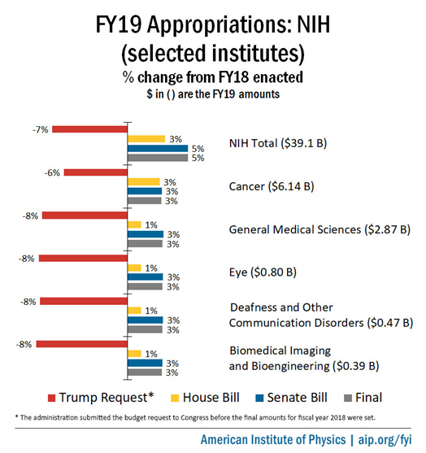
The US is still investing…
Notes:
Among the pieces of salient evergreen or new data:
Evergreen= Canada’s lagging performance compared to other small nations. Canada’s declining GERD. Canada’s anomalous HERD sources.
New = Key G7 players investing heavily. As noted, earlier, Germany’s renewed federal-state agreement will increase research budgets by 3% per annum for another decade. In the US, see slide. Despite attempts by President Trump to cut the budgets of both the NIH and NSF, the Congress and Senate continue to vote through meaningful increases.

Slide 62
CONCLUSION
“Given global competition, the role of research in underpinning innovation and educating innovators, the need for evidence to inform policy-making, and the current unsettled conditions in the research ecosystem, the Panel firmly believes that this commitment is also among the very highest-yield investments in Canada’s future that any government could make.”
(I HAVEN’T CHANGED MY MIND…)
Notes:
Self-explanatory.

